Slide 1
2024 SHUJAAZ PULSE CHECKS AND MONTHLY DEEP DIVE SESSIONS OVERVIEW

Slide 2
2024 WILDLY IMPORTANT GOALS (WIGS)

Slide 3
THE NEXT TWO YEARS: FROM STEREO TO SURROUND-SOUND
SHUJAAZ INC VISION & MISSION
WE BELIEVE THAT YOUNG PEOPLE CAN TRANSFORM SOCIETY FOR THE BETTER
THAT’S WHY WE BREAK DOWN BARRIERS SO THAT YOUNG PEOPLE CAN TAKE CONTROL OF THEIR FUTURES.
SHUJAAZ STRATEGY
Notes:
THIS IS

Slide 4
THE NEXT TWO YEARS: FROM STEREO TO SURROUND-SOUND
OUR NORTH STAR
SHUJAAZ IS THE GO-TO MEDIA BRAND FOR YOUNG PEOPLE IN KENYA & TANZANIA
AND SHUJAAZ INC IS RECOGNISED AS A GLOBAL LEADER IN MEDIA FOR SOCIAL CHANGE
SHUJAAZ STRATEGY
Notes:
IS WE ACHIEVE THIS – WE’LL ACHIEVE OUR VISION & MISSION

Slide 5
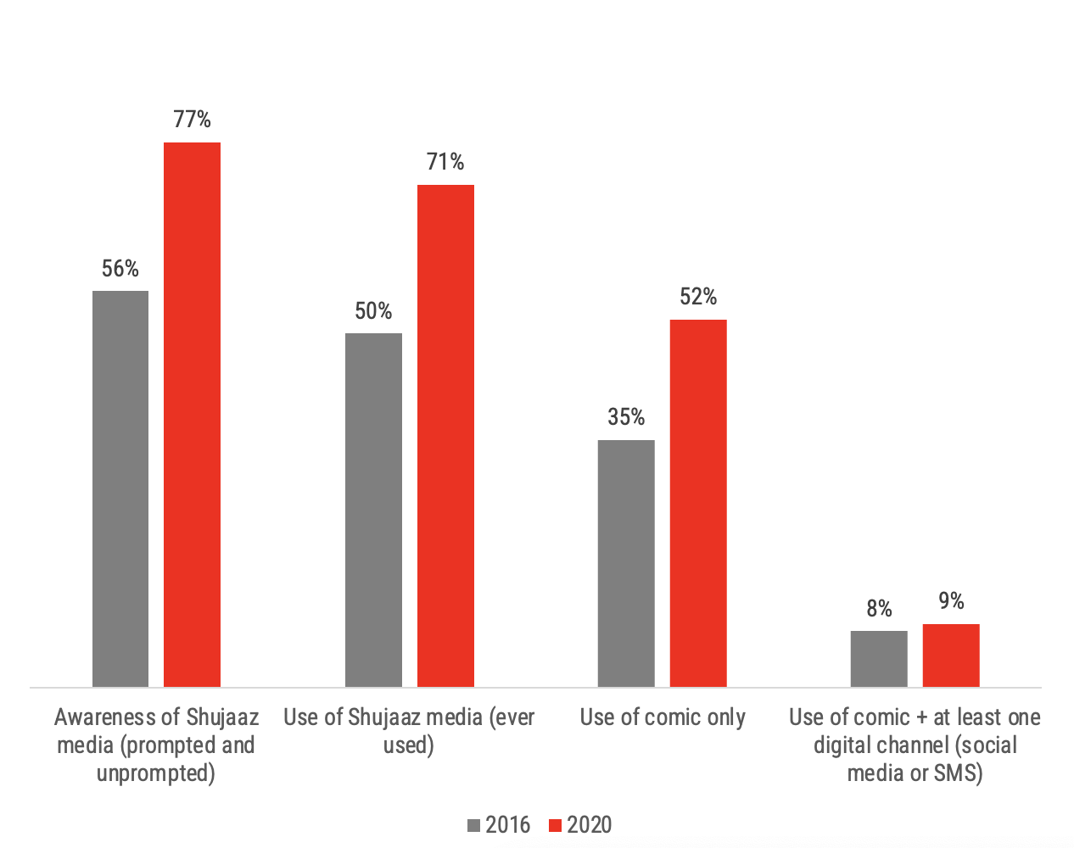
THE TWO-YEAR SPRINT
THE NEXT TWO YEARS: FROM STEREO TO SURROUND-SOUND
Get back to
in 24 months
70%
Grow online users to
in 24 months
50%
For Shujaaz to become the ‘go-to’ brand for all young people – and to drive globally-leading social change, we need to create a truly ‘surround-sound’ multi-touch-point brand experience for young people. Where the clout of our analogue media, is met by the impact of our online content.
Our theory of change evidences that it’s when young people engage with more than one-touch-point that change happens at pace.
(analogue reach)
SHUJAAZ STRATEGY
Notes:
2 YEAR GOAL – INCREASE OUR REACH & ENGAGMENT. OFFLINE AND ONLINE.
ONLINE IS THE BIG STRETCH.

Slide 6
SHUJAAZ MEDIA
=
REFRESHED BRAND
+
NEW DIGITAL STRATEGY
+
REFRESHED MEDIA MIX
DIGITAL DRAMA
ONLINE FORMATS
COMIC
WATCH PARTIES
+
CONSTANT TESTING & LEARNING
SCRUMS
MONTHLY REPORTS
QRAPS
ANNUAL SURVEY
MONEY
CURRICULUM OF SKILLS & PROPENSITY TO SUCCEED ATTRIBUTES
DRAMA SERIES
IDENTIFY WHERE EACH TOPIC & THEME SITS IN EACH EPISODE AND USE TO SPRINGBOARD INTO A SERIES OF ONLINE & OFFILINE FORMATS
WIG 2
BRAND
LOVE
WIG 1
GROW & ENGAGE
WIG 3
LIVES CHANGED
ONLINE FORMATS
EVERY TOPIC IN THE DRAMA IS UNPACKED & EXPLORED EACH WEEK WITH DIFFERENT FORMATS E.G. REACTION VIDS, LIVE CHATS, KWA STRIIT & WEBTOONS
SRH
KEY THEMES AND OUTCOMES / BEHAVIOURS
TRACK
WEEKLY SCRUM
MONTHLY REPORT
QRAP
TRACK
QRAP
YOUTH PANEL
+ SMS SURVEY
FAN STORIES
ANNUAL
ANNUAL SURVEY
OFFLINE FORMATS
EVERY TOPIC IN THE DRAMA IS UNPACKED & EXPLORED EACH MONTH IN THE COMIC & SUPERFAN LED WATCH PARTIES, FESTIVALS ETC

Slide 7
Item | Review Period | Metrics
PULSE CHECKS PLATFORMS: FB, IG, TT | Weekly | Reach - How many people have seen posts on our social channels and how the content spreads across social networks. These are unique viewers of a piece of content . Engagement Rate - Likes, reactions, comments, shares & saves Deep Engagement- Shares, comments, Retweets, saves Video views
MEDIA DEEP DIVES PLATFORMS: FB, IG, TT, YT,SMS WHATSAPP | Monthly | ++ Everything above including these below will be tracked on monthly basis Engagement per post - Engagement (likes, reactions, shares, comments) / reach Deep Engagement rate - Deep engagement / Reach *100% Video, average watch time, length for each platform. WhatsApp: Status views , Weekly number of contacts enrolled No of SMS Campaign performance Content format performance
SCOREBOARDS
TRACKING, MEASUREMENT, REPORTING
Notes:
800,000 copies distributed
2.5m reached online
Nationally trending

Slide 8
How an hour for a weekly pulse check will look like;
Data Deep Dive Wins & Trends
Present platform data at a high-level
Visual snapshot of positive metrics/trends
Share 2-3 top performance wins from the past week
Discuss what worked and why
Surface any issues or anomalies
Content Analysis
Show 2-3 pieces of top/poor performing content
Crowdsource hypotheses on why they performed that way
Interactive session & Lightning Round
Identify one opportunity for improvement
Collaborate on new ideas to test based on insights shared
Everyone shares a quick data-driven insight, trend, or idea
Looking Ahead: Recap decisions and next steps
Session Expectation:
This will be an interactive session to discuss the above
Everybody will be expected to have reviewed the deck shared on Tuesday and to come to the meeting with ideas, suggestions etc.
PULSE CHECK AGENDA
WEEKLY MEDIA DEEP DIVES

Slide 9
SAMPLE SLIDES

Slide 10
TARGET 2024
SUGGESTED TARGET
1. 10,000 number of new subscribers on YouTube after 24 episodes |  |  |  |  |  |  |  |  | Target no 3
2. 50,000 number of new followers on IG / TT / FB/WHATSAPP after 24 episodes. |  |  |  |  |  |  |  |  | Reach: 8,298,634.3
3. 10% Increased engagement with Shujaaz content on our online channels monthly |  |  |  |  |  |  |  |  | Engagement Rate: 2.31%
 |  |  |  |  |  |  |  |  | Deep Engagement: 28,427.3
 |  |  |  |  |  |  |  |  | Average Watch Time:
 |  |  |  |  |  |  |  |  | FB: 33.22
 |  |  |  |  |  |  |  |  | TT: 47.982
 |  |  |  |  |  |  |  |  | YT: 40.249

Slide 11
WEEK ON WEEK OVERALL PERFOMANCE: KENYA
REACH
TARGET: 1.75M
Interpretation
Contraceptive content and dilema
High Engagement: A post by Maria Kim discussing family issues reached 82,909 people and had an engagement rate of 1.67%. This suggests that personal stories relating to family and relationships are highly engaging
Photo format preforms better and generate most reach and Text format generated most deep engagement esp on week of 13th
Consistence of DJT and Pendo on maintaining deep engagement, with exploring of UGC that trigger people to conversate.
FB Reels & Photo recorded the highest form number of total shares which contribute in Deep engagement.
Reach and Shares are highly dependant on each other.
ENGAGEMENT RATE
TARGET: 3%
DEEP ENGAGEMENT
TARGET:5,350
Notes:
Data periods. Weekly- Mon to Sunday: why?

Slide 12
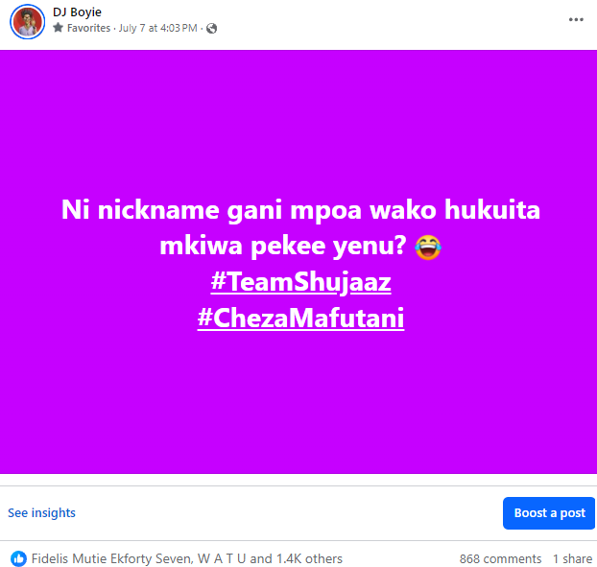
BEST PERFOMING SOCIAL MEDIA POST- REACH
Post format: Facebook Overlay ( Text )
Why: Clear CTA
Insights & Takeaways:
Top performing according to reach and deep engagement..
Relatable to young people and triggering

Slide 13
MBOGINITRU TV SERIES

Slide 14
MBOGINITRU PROMO PERFORMANCE- JULY 2024
Notes
73 link clicks from our FB pages on week 1 and 41 on week of 8th July
Including other external traffic sources all video views were 489
Instagram is trafficking most of the engagement, you could see more video views are coming from Instagram.
Collaoration feature is yielding results, with over +200% growth rate over the last 14 days
Question: what the plan of pre and post promotion of episodes? What’s the distribution like (to help tracking and attribution)
Should we use Tiktok videos and/or Instagram reels not for redirection but for viewer’s consumption. Redirecting them to the other platform does not necessarily work.

Slide 15
MBOGINITRU PROMO PERFORMANCE- JULY 2024
Notes
16 link clicks from our FB pages
Including other external traffic sources all video views were 489
Question: what the plan of pre and post promotion of episodes? What’s the distribution like (to help tracking and attribution)
Should we use Tiktok videos and/or Instagram reels not for redirection but for viewer’s consumption. Redirecting them to the other platform does not necessarily work.
Action point for SM team to consider: is the level of effort placed on promoting STRA yielding the expected results

Slide 16
Average % viewed shows how much of your video viewers are watching
Average view duration reveals how long viewers are staying engaged
Impressions CTR indicates effectiveness of enticing viewers to click from impressions
CAMPAIGN PERFORMANCE-MBOGINITRU PERFOMANCE ON YOUTUBE
YOUTUBE:
Highest Engagement from YouTube Search: This source has the highest average percentage viewed (14.8%) and the longest average view duration (5:42).
External Traffic: External sources also show high engagement with 11.6% average percentage viewed and 4:31 average view duration.
Channel Pages: Contribute significantly to views (614) and impressions (5,966) but have a lower average percentage viewed (3.6%) and shorter average view duration (1:23).
Playlists and Suggested Videos: Playlists have a high impression click-through rate (17.3%) but low views and watch time. Suggested videos have the lowest engagement metrics across the board.
Episode 1
Returning viewers accounted for 73% of views, indicating a strong loyal audience for our content. Focus should be on continuing to serve this group while also attracting new viewers
Click-through rate is decent but leaves room for improvement. Lets keep trying A/B testing thumbnails, titles, and descriptions to make the video stand out more in feeds
Test improvements to titles, thumbnails, end screens and calls-to-action to boost clicks, shares, comments and subscriptions.
Notes:
Optimize for Browse Features: Since it generates a significant portion of views, focus on creating appealing thumbnails and titles to increase visibility on YouTube's homepage and recommendations.
Enhance YouTube Search Performance: Given the high average view duration from search, continue to optimize our video titles and descriptions for relevant keywords.
Leverage Channel Pages: Capitalize on the high click-through rate from channel pages by ensuring our channel is well-organized and showcases your best content.
Improve Playlist Engagement: While playlist click-through rates are high, work on increasing the average view duration in playlists to keep viewers engaged longer.

Slide 17
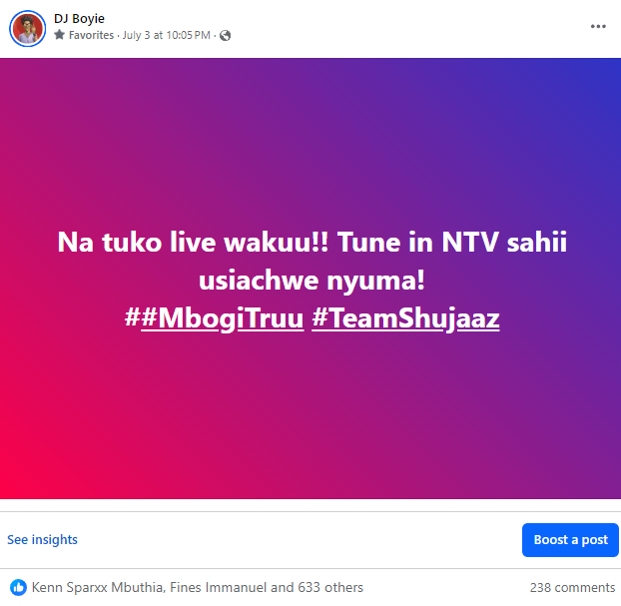
BEST PERFOMING SOCIAL MEDIA POST- DEEP ENGAGEMENT-SHUJAAZ TV
Post format: Facebook Overlay ( Text )
Why: Clear CTA
Insights & Takeaways:
Top performing according to reach and deep engagement..

Slide 18
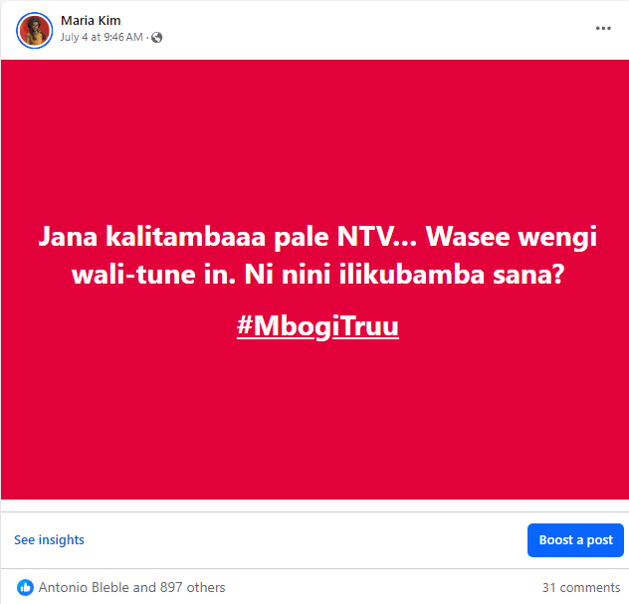
BEST PERFOMING SOCIAL MEDIA POST- DEEP ENGAGEMENT-SHUJAAZ TV
Post format: Facebook Overlay ( Text )
Why: Clear CTA
Insights & Takeaways:
Top performing according to reach and deep engagement..

Slide 19
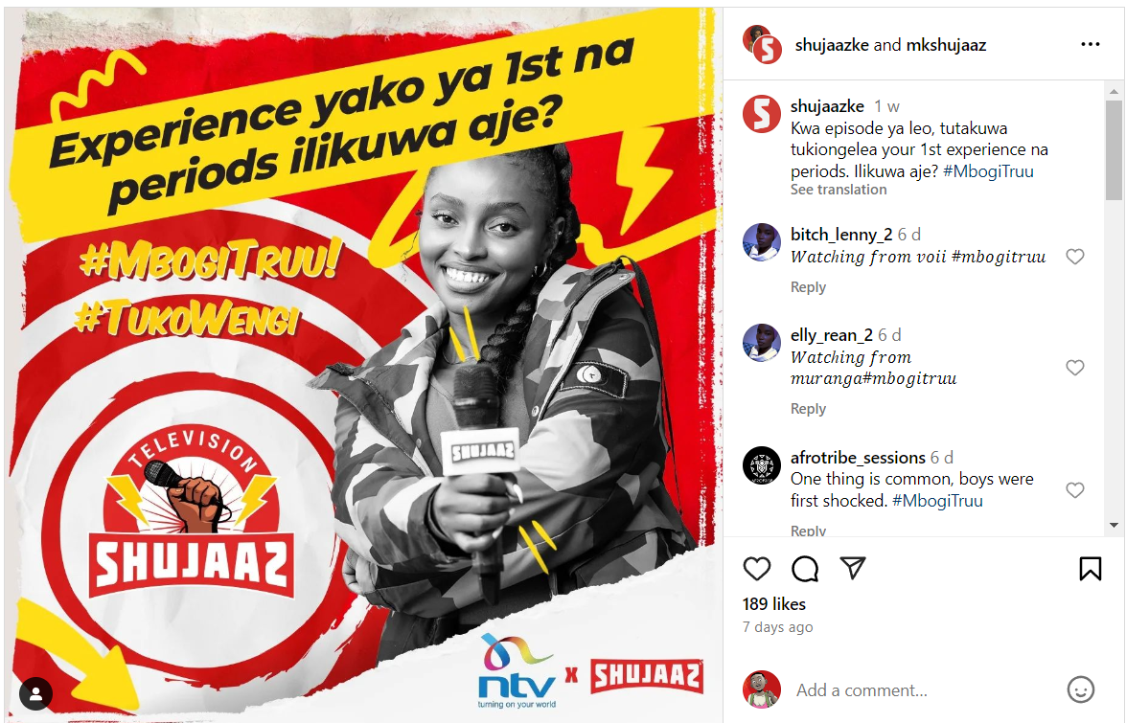
BEST PERFOMING SOCIAL MEDIA POST- DEEP ENGAGEMENT-SHUJAAZ TV
Post format: Photo
Why: Clear CTA
Insights & Takeaways:
a collaboration with MK.
Deep engagement over 266

Slide 20
KEY INSIGHTS
#1. WHAT WORKED, WHY?
#2. AREAS FOR IMPROVEMENT
#3. LOOKING AHEAD, WHAT NEXT?
Consistently use of dilemma and controversial topic to evoke audience’s reactions.
For characters with a small fan base, Community lead should pay close attention to when fans are most actively engaging with content. By posting during peak activity periods, this will increase visibility and traction even without a large built-in audience.
Social team to revamp and do a strategy for Instagram.
Tracking & experimenting the impact of comic strips under the #LifeYANGU
WEEKLY PULSE CHECK

